Slide 1
EXPLORATORY DATA ANALYSIS
The MUST do

Slide 2
One of the first things we want to do with any data set is examine the data using exploratory data analysis.
Graphical techniques
Numerical techniques

Slide 3
Graphical EDA
The type of graph that is used depends on the level of measure of our data.
Categorical vs numeric
Discrete vs continuous
And on the type of experiment or observational study
single variable
response variable and explanatory variable(s)
time series
multivariate data

Slide 4
Categorical variable
Bar graphs – for a single sample categorical variable is a graph with one axis corresponding to the categories and the other axis equal to the frequency of those categories in the sample

Slide 5
Categorical variables
Pie charts – a circular chart showing the percentage of variables in each category.

Slide 6
Numerical Variables
Histograms – an estimate of the probability density (or distribution) function of the population. Similar to a bar chart except the area of the bar corresponds to the proportion of responses that fall into that bin. The histogram gives an idea of the shape of the underlying population. They can be symmetric like this one.

Slide 7
Numerical variables - histograms
Or right skewed or left skewed

Slide 8
Numerical data – histograms
Or bimodal

Slide 9
Numerical variables - histograms
The shape of the histogram gives information about the possible shape of the underlying population. This gives us an idea about what sort of model will be useful for analysis.
symmetric – normal, t-distribution
skewed – gamma, other
All models are wrong – some are useful.
George Box

Slide 10
Numerical variables – box plot
A box and whiskers plot has five lines. The box has the median value and the upper and lower quartile value. The whiskers are the smallest and largest values. Outliers can appear as dots beyond the whiskers.
For the sample:
Median = the value such that half of the data lies below it
First quartile – the value that is the median of the lower half of the data
Third quartile – the value that is the median of the upper half
outliers – values that are much different than the rest of
the data

Slide 11
Numerical data – box plots

Slide 12
Numerical variables – box plot
Useful for comparing groups visually. Here you can see the boxes are very different.

Slide 13
Numerical variables – other plots
Time series – the variable is plotted against time. Interest is in finding patterns over time.

Slide 14
Numerical variables – response vs explanatory
Often we measure response variables that are related to explanatory variables. Interest is in looking for a relationship between the two. Here a scatterplot is used to look for patterns.

Slide 15
Numerical variables – response vs explanatory
Sometimes the relationship appears to be linear.

Slide 16
Numerical variables – response vs explanatory
Sometimes there appears to be no relationship.

Slide 17
Numerical variables – response vs explanatory
Sometimes there is a relationship but it is not linear.

Slide 18
Numerical variables – response vs explanatory
The type of relationship informs the analysis as we will see later in this course.

Slide 19
Numerical variables – multivariate data
Often times we measure multiple variables on each subject in a study. Interest is in each variable and the relationships between them. Graphically for exploratory analysis we can do scatterplots of each pair of variables.

Slide 20
Numerical variables – multivariate data

Slide 21
Multivariate graphs

Slide 22
Multivariate graphs

Slide 23
Numerical EDA
There are three types of numerical EDA of most interest for single variables (or within each of a set of variables).
Central tendency
Variation
outliers

Slide 24
Central Tendency
As with graphical EDA the level of measure determines which measure of central tendency makes sense.
Level of Measure | Measure of Central Tendency
nominal | mode
ordinal | Median, mode
Interval/ratio | Mean, median, mode

Slide 25
Central Tendency
Mode
The mode is the value in the sample with the highest frequency. For a categorical variable it is the value with the highest bar in a bar chart. For continuous data it may be less useful than for categorical or discrete data.

Slide 26
Central tendency
Median
The sample median is the value of the ordered sample that has half of the sample below and half above. If there is an odd number of observations the median is the one in the middle. If there is an odd number of observations the median is the average of the middle two numbers. The sample median is an estimate of the population median.

Slide 27
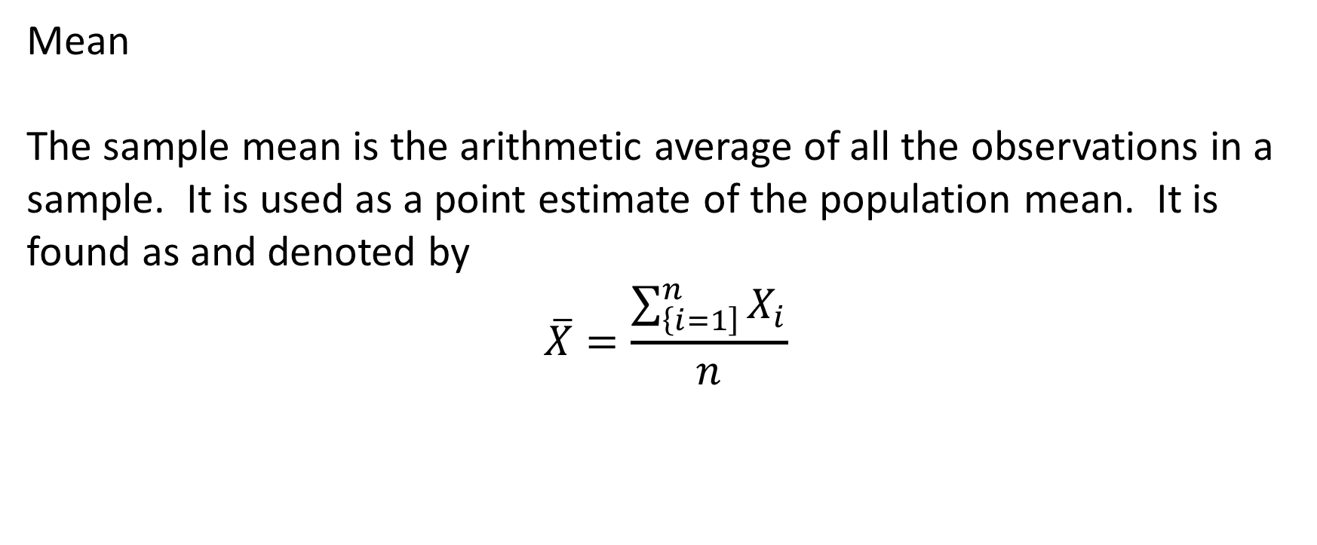
Central tendency
Mean
The sample mean is the arithmetic average of all the observations in a sample. It is used as a point estimate of the population mean. It is found as and denoted by
$$\overline{X}=\frac{\sum_{\left\{i=1\right]}^{n}{X_{i}}}{n}$$

Slide 28
Central tendency
The sample median is more sensitive to outliers than the sample mean or sample mode. This is expressed as the sample median being more robust to outliers than the sample mean. If you consider the salaries of 5 professional basketball players: 4 of which make $100,000 per year and the 5th makes $1,000,000 per year. The sample median is $100,000 while the sample mean is $280,000 since it is greatly affected by the outlier millionaire.

Slide 29
variation
The measures of variation are intended to determine how spread out the data is. The two measures we will look at are
Range
Sample variance
These measures are appropriate with interval/ratio data only.

Slide 30
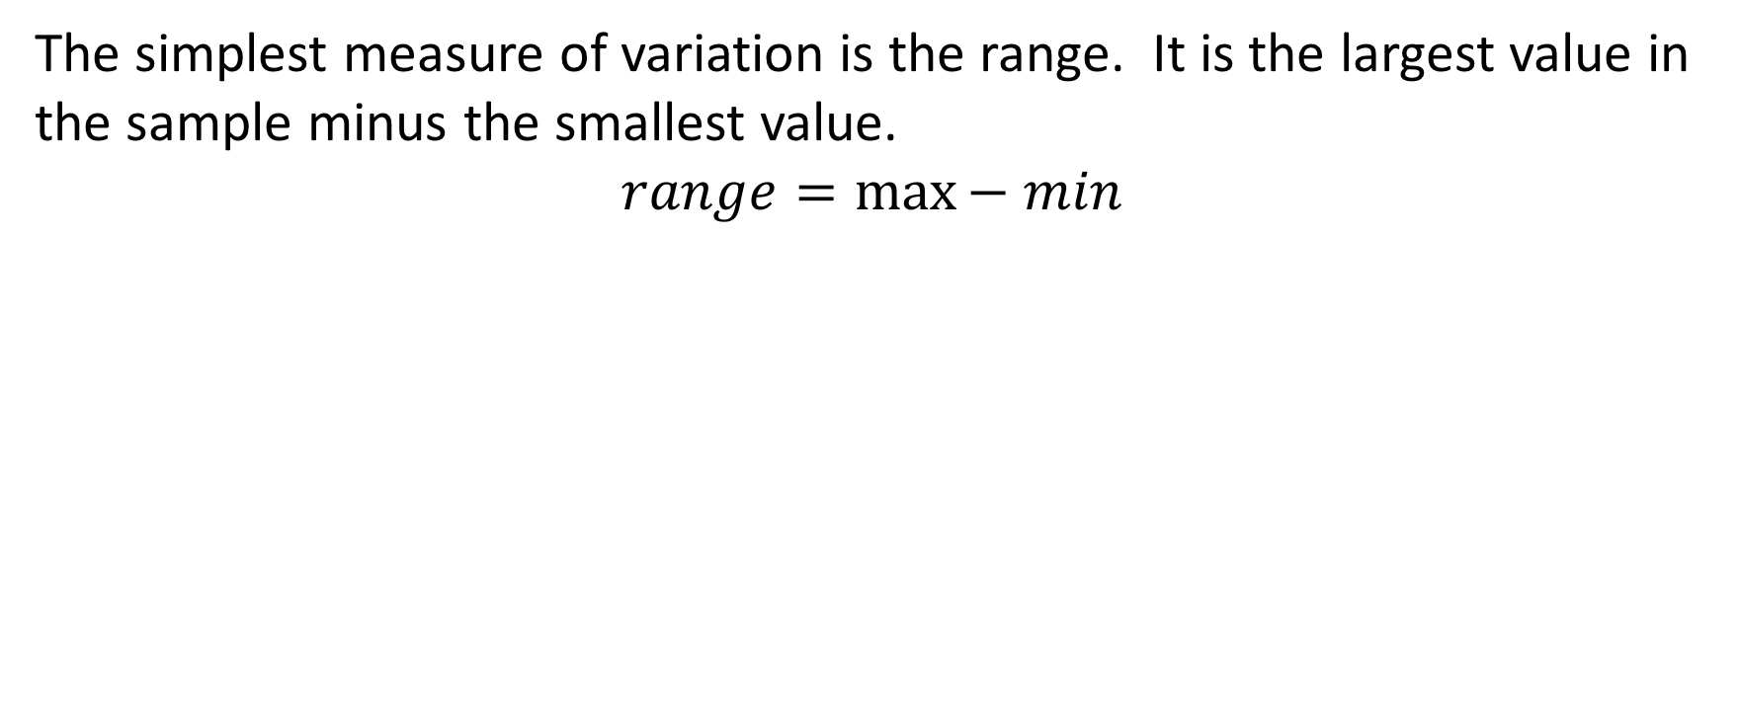
Variation – range
The simplest measure of variation is the range. It is the largest value in the sample minus the smallest value.
$$range=\max{− min}$$

Slide 31
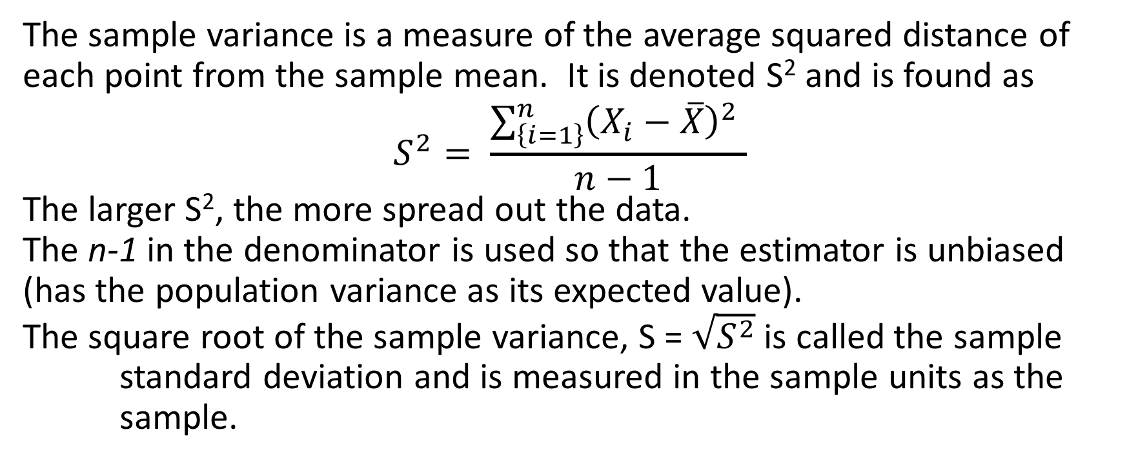
Variation – sample variance
The sample variance is a measure of the average squared distance of each point from the sample mean. It is denoted S² and is found as
$$S^{2}= \frac{\sum_{\left\{i=1\right\}}^{n}{{\left(X_{i}−\overline{X}\right)}^{2} }}{n−1}$$
The larger S², the more spread out the data.
The n-1 in the denominator is used so that the estimator is unbiased (has the population variance as its expected value).
The square root of the sample variance, S = $\sqrt{S^{2}}$is called the sample standard deviation and is measured in the sample units as the
sample.

Slide 32
Outliers
Outliers are values in the sample that are much different (larger or smaller) than the remaining values.
Care must be taken in dealing with outliers. You should never remove them without checking with the expert in the field as these could be measurement errors or actual values that occur in the tail of a distribution.
Anomaly detection – the points of interest are the outliers and the greater mass of data serves only to define “normal” against which anomalies are measured.

Slide 33
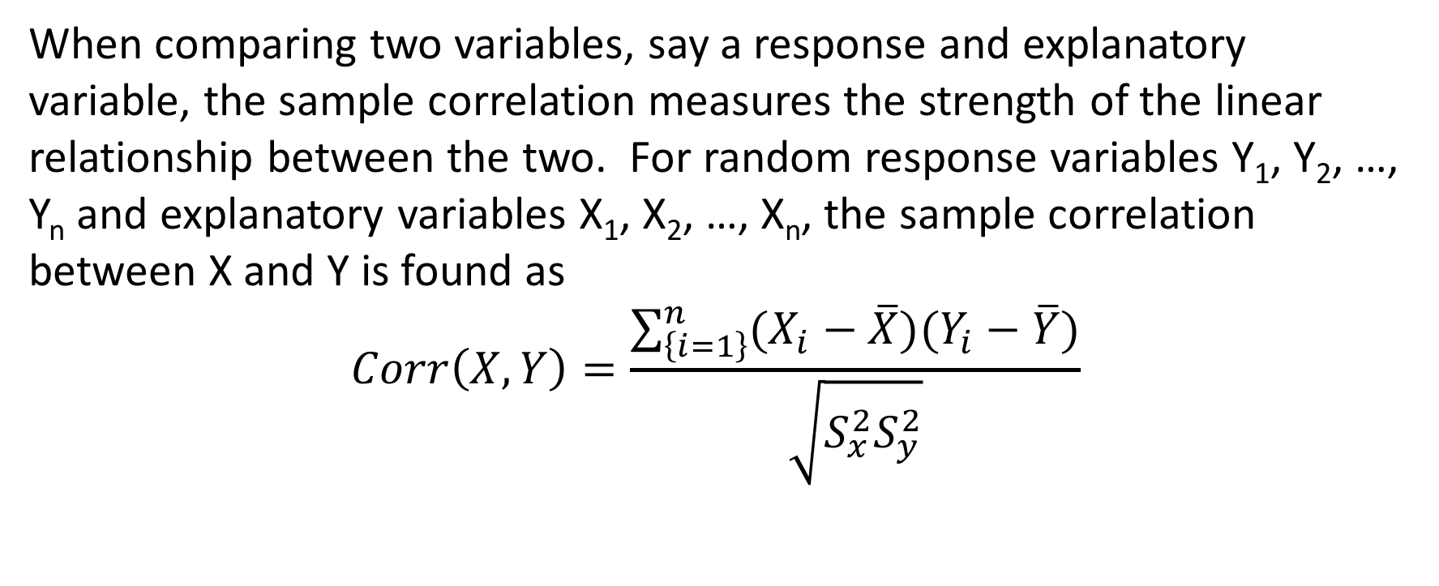
Measures of association
When comparing two variables, say a response and explanatory variable, the sample correlation measures the strength of the linear relationship between the two. For random response variables Y₁, Y₂, …, Y_{n} and explanatory variables X₁, X₂, …, X_{n}, the sample correlation between X and Y is found as
$$Corr\left(X,Y\right)=\frac{\sum_{\left\{i=1\right\}}^{n}{(X_{i}−\overline{X}})(Y_{i}−\overline{Y})}{\sqrt{S_{x}^{2}S_{y}^{2}}}$$

Slide 34
Measure of Correlation
The sample correlation is always between -1 and 1
Negative values indicate a negative linear relationship – as one variable increases
the other decreases

Slide 35
Measure of correlation
Positive values of sample correlation are indicative of a positive linear relationship – as one variable increases the other also increases.

Slide 36
Measure of correlation
Sample correlation values close to zero could mean there is no relationship between the variables,

Slide 37
Measure of correlation
Or that there is no linear relationship between the variables

Slide 38
Summary EDA
Whatever analyses you have in mind or anticipate it is important to look at your data – graphically and numerically first.
Example – suppose you have a regression analysis in mind, which is the fitting of a line to response - explanatory variables. If you plot the data and compute the sample correlation and do not observe any relationship between the two variables, regression will not be a useful tool and you can easily explain why to your clients.

